Slide 1
ECE 699
Novelty Detection in Runtime Data
Professor: Prof. Sebastian Fischmeister
Presenter: Nikhil Sharma
Student ID: 20989488
Masters of Engineering in Electrical and Computer Engineering

Slide 2
Problem Statement
Given a univariate time series dataset for training, the task is to distinguish any novel patterns in a new time series that deviate significantly from those observed in the training dataset.

Slide 3
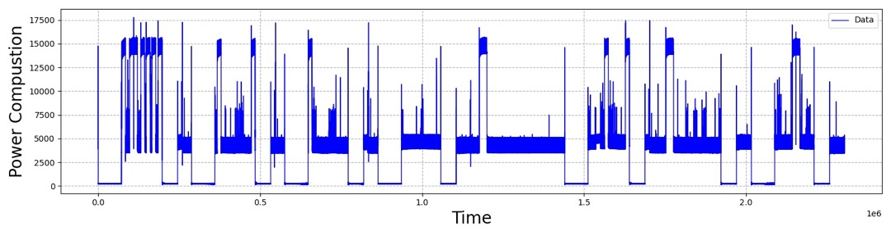
Data
160 Hours of Labeled Power Consumption Dataset of Computer
This dataset contains the power consumption and ground truth for 40 runs of 4 activity hour
5 States – UNKOWN, OFF, IDLE, HIGH LOAD, REBOOT

Slide 4
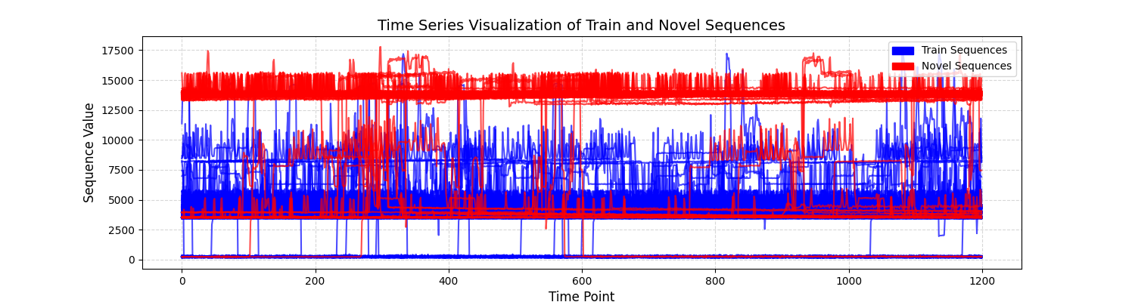
Train Sequences vs Novel Sequences
1 minute long sequences ( High Load shown as Novelties)
1200 values in a single sequence ( Non - Overlapping)
X_train: 80 % of Train Sequences ( 5 Fold Cross Validation)
X_test: 20 % of Train Sequences + 100 % of Novel Sequences

Slide 5
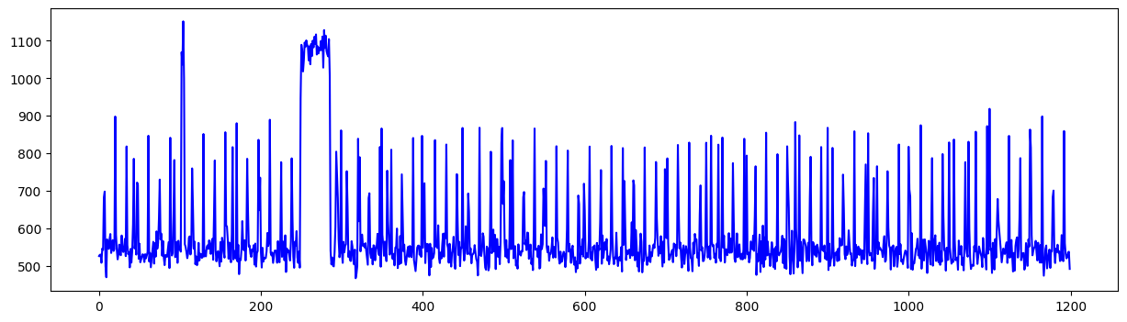
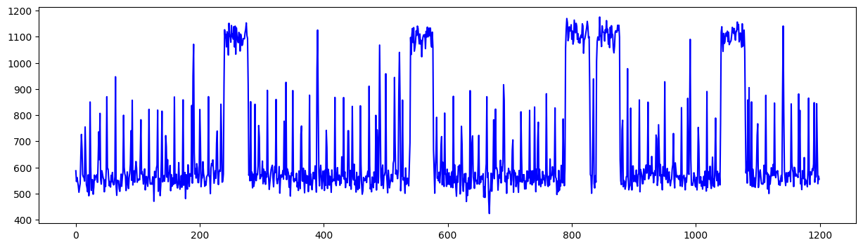
Second Dataset

Slide 6
Algorithms
Machine Learning
XGBoost
K Means clustering
DBSCAN
One Class SVM
Deep Learning
Autoencoder
CNN
VAE ( Variational Autoencoder)
GANs

Slide 7
XGBoost
Training:
The XGBoost model is trained using X_train as both the input and output.
This means the model learns to map each input sequence in X_train to itself, effectively learning the normal structure or pattern of your data.
Testing (Novelty Detection):
When a new sequence (which is different from the training data in X_train) is fed into the trained model, the model attempts to reconstruct this input. If the new sequence is an anomaly or novel compared to the training data, the model's reconstruction will not be accurate, leading to a higher reconstruction error.
I took reg:squarederror ( MSE ) because it is sensitive to large deviations in the output

Slide 8
Results: XGBoost
For Original Data, separate classes are taken as novelty and F scores are reported
Off as Novelty (0) - 97.24 %
Idle as Novelty (1) - 99.37 %
High Load as Novelty (2) - 99.45 % (98.81 % K Fold with 5 folds)
Tested with K - Fold cross validation, and the results yield almost same F score
Less change of overfitting ( by design) than other Tree Based Models because of in-built regularizer

Slide 9
K Means Clustering
Training:
Determine the optimal number of clusters using the Elbow Method.
Train the K-Means model on 'normal' data to find cluster centroids.
Novelty Detection
Calculate the distance of each test data point to the nearest cluster centroid.
Set a distance threshold based on a percentile of training data distances or other criteria.
Label data points as novel if their distance to the nearest centroid exceeds this threshold.

Slide 10
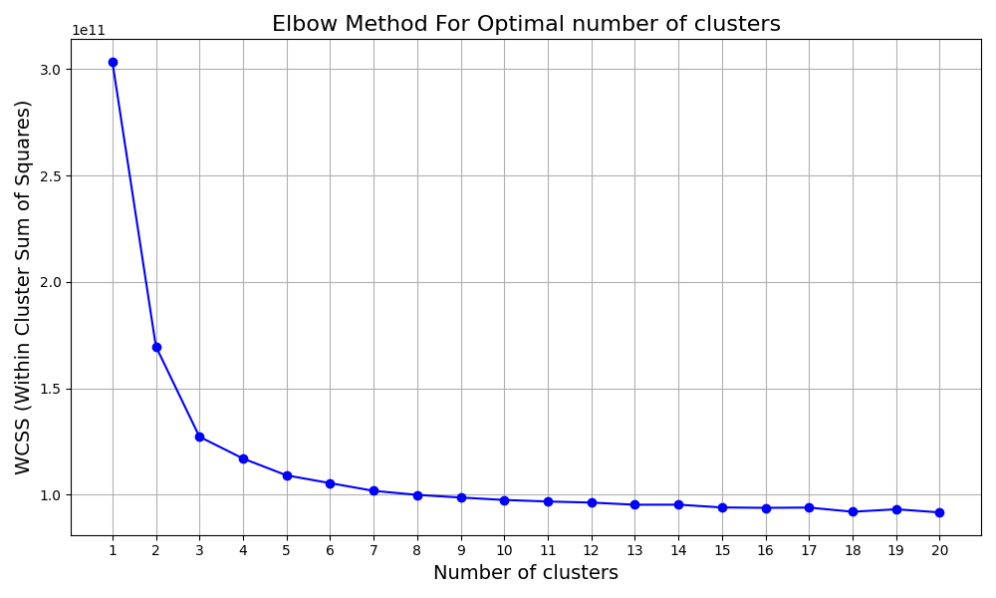
Elbow Method

Slide 11
Results: K Means Clustering
For Original Data, separate classes are taken as novelty and F scores are reported
Off as Novelty (0) - 62.99 %
Idle as Novelty (1) - 99.37 %
High Load as Novelty (2) - 99.255 % (99.05 % K Fold with 5 folds)

Slide 12
One Class SVM
Training:
Figures the smooth decision boundary around 1 class. ( In our case, normal data)
Testing (Novelty Detection):
During testing, the model evaluates new sequences against the learned pattern.
Sequences that fall outside the learned boundary (significantly different from X_train) are flagged as novel.

Slide 13
Results: One Class SVM
For Original Data, separate classes are taken as novelty and F scores are reported
Off as Novelty (0) - 81.37 %
Idle as Novelty (1) - 99.68 %
High Load as Novelty (2) - 97.7 % (96.25 % K Fold with 5 folds)

Slide 14
Deep Learning Techniques: Training
Autoencoder & CNN Autoencoder
Encoder and Decoder Architecture.
Encoder encodes the data ( fully connected layers for Autoencoders, Convolutional layers for Conv. AN) in the latent space ( bottleneck layer)
Learns to Decode the same pattern as input and optimizes the reconstruction error
Variational Autoencoder
Similar to a standard autoencoder but introduces a probabilistic twist.
The encoder outputs parameters of a probability distribution representing the data.
The decoder reconstructs the input from samples drawn from this distribution.
Optimizes not only for reconstruction error but also for maintaining a regularized latent space (using KL divergence).

Slide 15
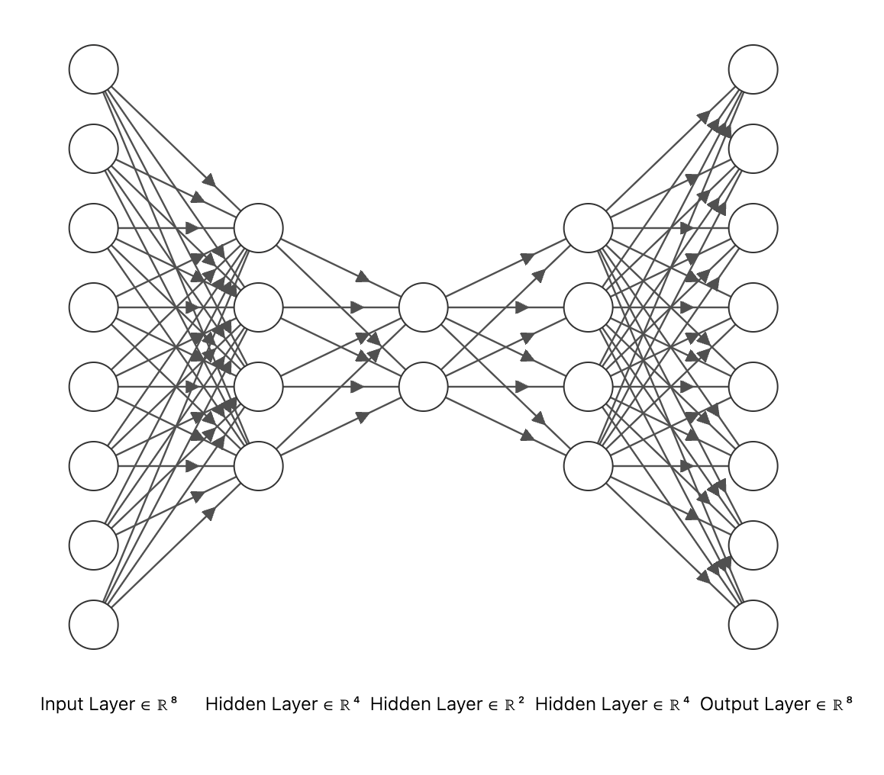
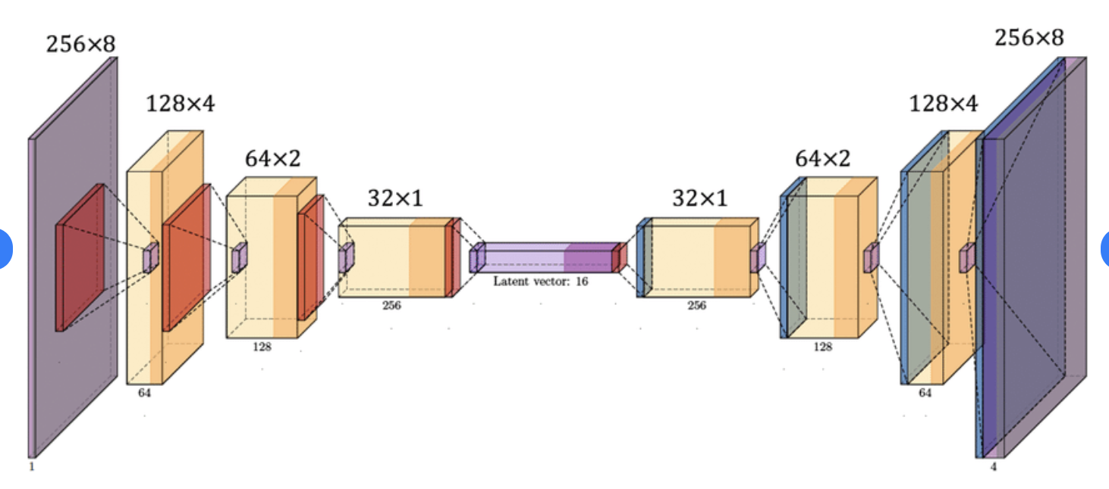
TYPICAL ARCHITECTURE OF AUTOENCODER

Slide 16
GAN’s
Comprises two models: a generator and a discriminator.
The generator creates data, and the discriminator evaluates it, discerning between generated and real data.
Trained in an adversarial process where the generator improves its data generation based on feedback from the discriminator.
The objective is for the generator to create data indistinguishable from real data to the discriminator.

Slide 17
Deep Learning: Novelty Detection
AN & Conv. AN & VAE
The neural network will try to reconstruct the testing data. If the reconstruction loss is too much, then the data is classified as Novel.
In autoencoder, the decoder will try to reconstruct the data from the latent space and in VAE the decoder will try to reconstruct the data from the probabilistic distribution space
GAN’s
Utilizes the discriminator to evaluate new data.
If the discriminator identifies the data as fake (generated), it can be considered novel.

Slide 18
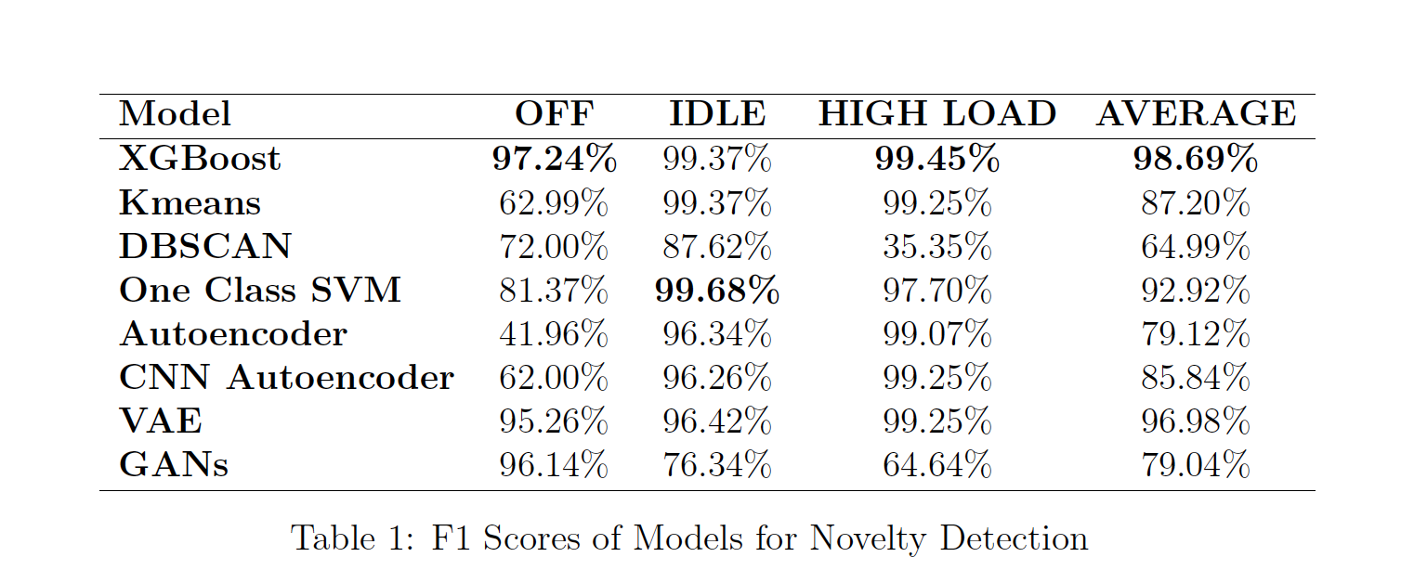
F1 SCORES

Slide 19
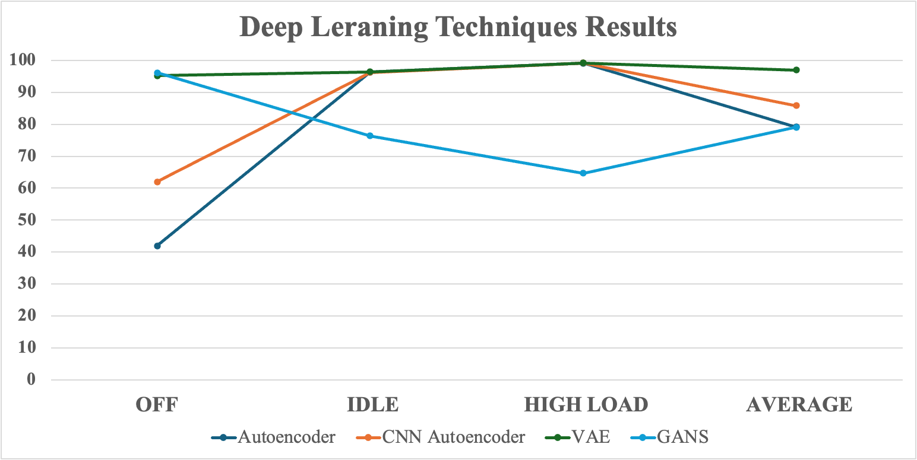
Results: Deep Learning Techniques
Deep Learning Techniques Results

Slide 20
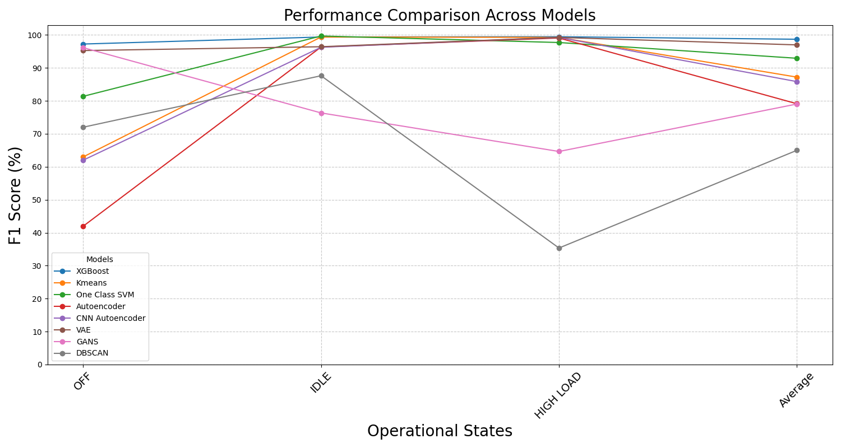
Results: All Models
XGBoost and VAE had the best performance across all trials

Slide 21
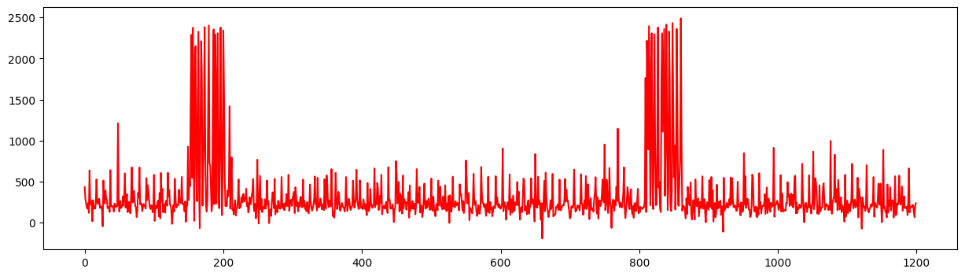
NOVELTIES ON NEW DATA
XGBOOST FLAGGED THESE TYPES OF NOVELTIES ( Same for Kmeans)

Slide 22
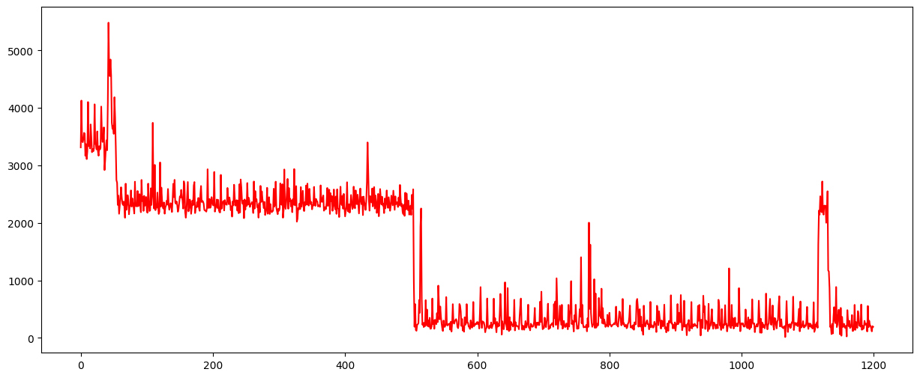
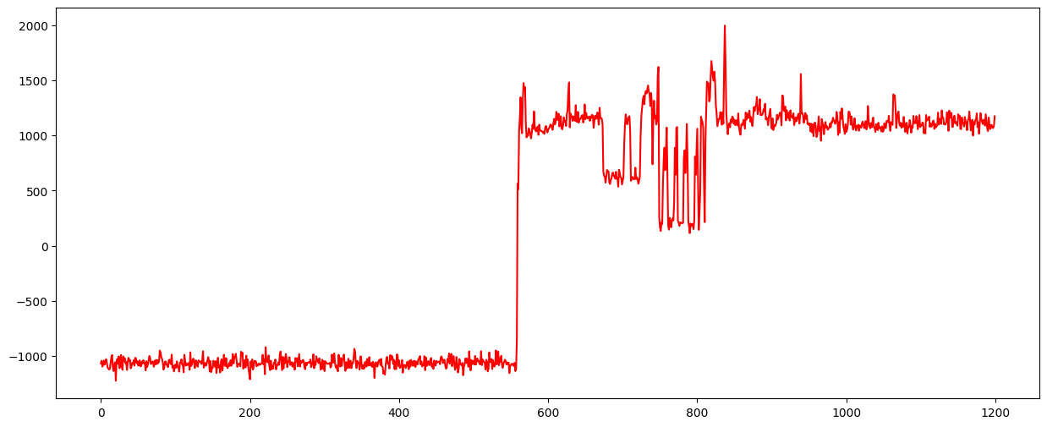
NOVELTIES ON NEW DATA – Kmeans

Slide 23
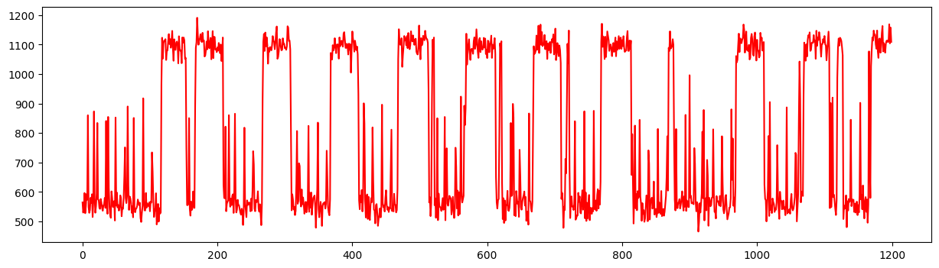
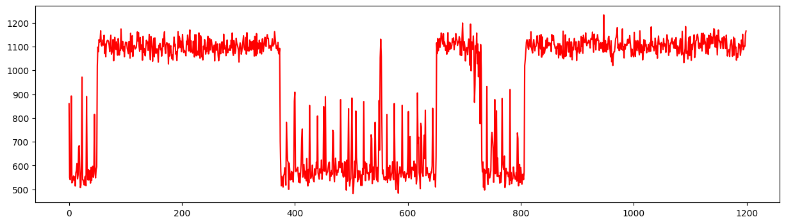
NOVELTIES ON NEW DATA – Deep Learning

Slide 24
Why XGBoost has the best performance?
Algorithm is robust to overfitting
It can handle imbalance data
Feature Importance and Selection
Robust to outliers

Slide 25
Thanks

